Slide 1
Unsupervised Speaker Recognition
Notes:
The problem that we wanted to solve is to be able to record a meeting/class and identify which particular person speaks at a specific time and what they speak.
It would be cumbersome and time consuming to record each speaker’s voice beforehand and train a speaker recognition model on the speakers’ voice. So we made a tool to predict the speaker without prior training on the speaker’s voice.

Slide 2

Approach
Supervised speaker recognition
8 speaker recognition model
Random speaker recognition model
Embedding vector and clustering

Slide 3
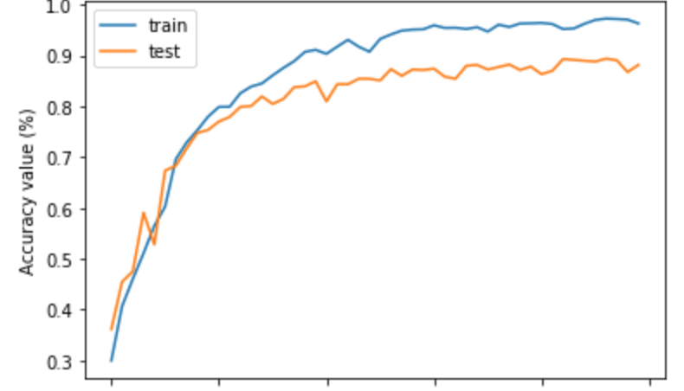
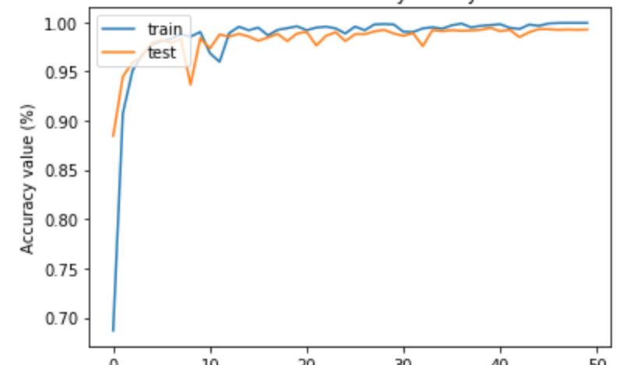
Result

